Slide 1
School start delay
Sleep
duration
Depression symptoms
Biological sex
Physical inactivity
Financial insecurity
Edited 1/21/2022

Slide 2
Threat
Pubertal development
Sleep
duration
Depression symptoms
Deprivation
Edited 1/21/2022

Slide 3
Full diagram

Slide 4
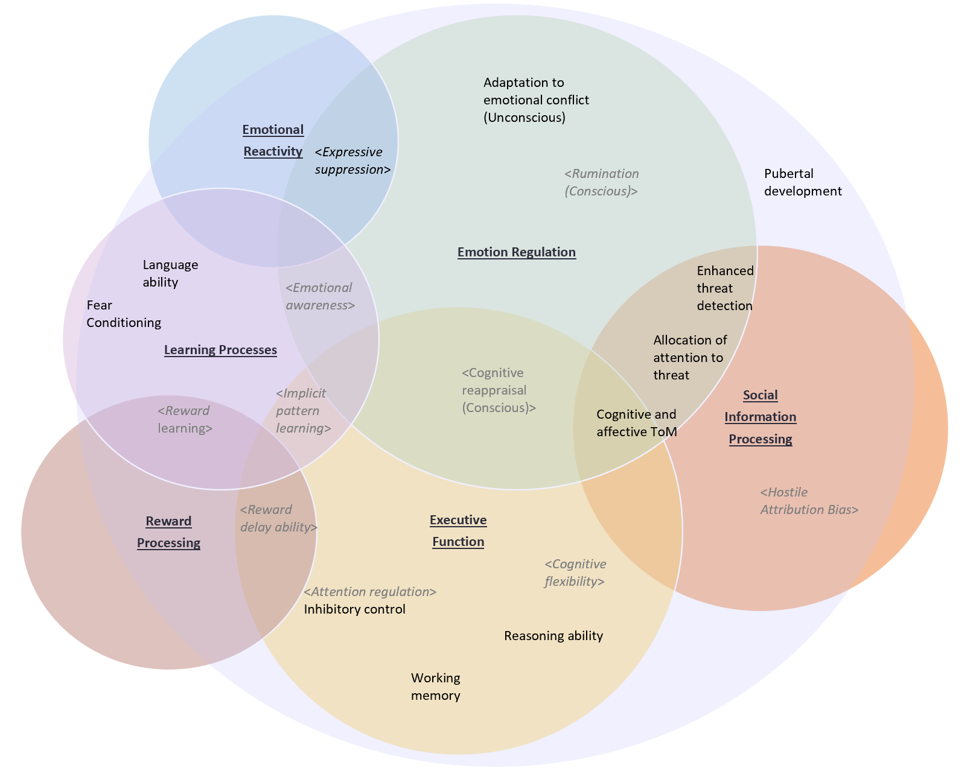
Threat
Psychopathology
Deprivation
Notes:
Neuroimaging research supports that threat and deprivation have distinct mechanisms of effect on psychopathology, suggesting the possibility of identifying early targets for prevention of psychiatric disorders.
A critical task from an epidemiologic perspective is to establish which precursor phenotypes, measurable on a population scale and targetable with intervention, most saliently reflect biological changes precipitated by deprivation and threat.
The proposed work will first examine a rich set of characteristics previously found to mediate the relationships between deprivation and threat and psychiatric outcomes over the lifecourse.
We will then turn our focus to one mediator – earlier pubertal development – that has been shown to predict elevated risk of psychopathology but that is differentially affected by deprivation and threat.
One understudied mechanism by which earlier puberty may enact psychosocial harm is prematurely curtailed sleep.
We will decompose the total effect of early puberty on adolescent depression symptoms into its natural direct effect and the natural indirect effect through weekday sleep duration. Lastly, we will use data from a natural experiment to explore the heterogeneity of effect of sleep duration on depression outcomes among high school students, with a two-pronged goal of learning about the etiology of depression and informing optimization of delaying high school start times to protect adolescent mental health.

Slide 5
Gray out everything but puberty bubble

Slide 6
Social
Information
Processing
Executive
Function
Emotion Regulation
Reward
Processing
Emotional
Reactivity
Learning Processes
Adaptation to emotional conflict (Unconscious)
<Expressive suppression>
<Rumination (Conscious)>
Pubertal development
Language ability
<Emotional awareness>
Enhanced threat detection
Fear Conditioning
Attention bias to threat
<Cognitive reappraisal (Conscious)>
<Implicit pattern learning>
<Reward learning>
Cognitive and affective ToM
<Hostile Attribution Bias>
<Reward delay ability>
<Cognitive flexibility>
<Attention regulation>
Inhibitory control
Reasoning ability
Working memory
Edited 1/21/2022

Slide 7
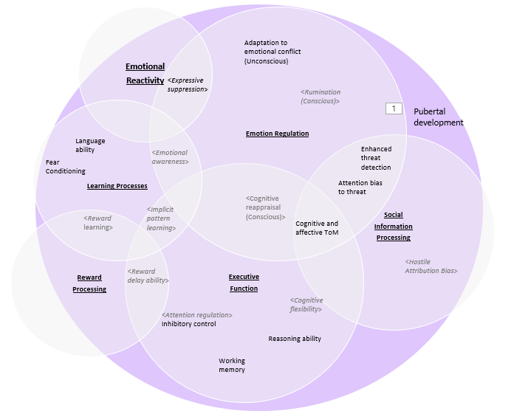
Threat
Psychopathology
Deprivation
Notes:
Neuroimaging research supports that threat and deprivation have distinct mechanisms of effect on psychopathology, suggesting the possibility of identifying early targets for prevention of psychiatric disorders.
A critical task from an epidemiologic perspective is to establish which precursor phenotypes, measurable on a population scale and targetable with intervention, most saliently reflect biological changes precipitated by deprivation and threat.
The proposed work will first examine a rich set of characteristics previously found to mediate the relationships between deprivation and threat and psychiatric outcomes over the lifecourse.
We will then turn our focus to one mediator – earlier pubertal development – that has been shown to predict elevated risk of psychopathology but that is differentially affected by deprivation and threat.
One understudied mechanism by which earlier puberty may enact psychosocial harm is prematurely curtailed sleep.
We will decompose the total effect of early puberty on adolescent depression symptoms into its natural direct effect and the natural indirect effect through weekday sleep duration. Lastly, we will use data from a natural experiment to explore the heterogeneity of effect of sleep duration on depression outcomes among high school students, with a two-pronged goal of learning about the etiology of depression and informing optimization of delaying high school start times to protect adolescent mental health.

Slide 8
Threat
Psychopathology
Deprivation
Notes:
Neuroimaging research supports that threat and deprivation have distinct mechanisms of effect on psychopathology, suggesting the possibility of identifying early targets for prevention of psychiatric disorders.
A critical task from an epidemiologic perspective is to establish which precursor phenotypes, measurable on a population scale and targetable with intervention, most saliently reflect biological changes precipitated by deprivation and threat.
The proposed work will first examine a rich set of characteristics previously found to mediate the relationships between deprivation and threat and psychiatric outcomes over the lifecourse.
We will then turn our focus to one mediator – earlier pubertal development – that has been shown to predict elevated risk of psychopathology but that is differentially affected by deprivation and threat.
One understudied mechanism by which earlier puberty may enact psychosocial harm is prematurely curtailed sleep.
We will decompose the total effect of early puberty on adolescent depression symptoms into its natural direct effect and the natural indirect effect through weekday sleep duration. Lastly, we will use data from a natural experiment to explore the heterogeneity of effect of sleep duration on depression outcomes among high school students, with a two-pronged goal of learning about the etiology of depression and informing optimization of delaying high school start times to protect adolescent mental health.

Slide 9
SAVE BELOW!!!!!!!!!

Slide 10
Threat
Psychopathology
Deprivation
Notes:
Neuroimaging research supports that threat and deprivation have distinct mechanisms of effect on psychopathology, suggesting the possibility of identifying early targets for prevention of psychiatric disorders.
A critical task from an epidemiologic perspective is to establish which precursor phenotypes, measurable on a population scale and targetable with intervention, most saliently reflect biological changes precipitated by deprivation and threat.
The proposed work will first examine a rich set of characteristics previously found to mediate the relationships between deprivation and threat and psychiatric outcomes over the lifecourse.
We will then turn our focus to one mediator – earlier pubertal development – that has been shown to predict elevated risk of psychopathology but that is differentially affected by deprivation and threat.
One understudied mechanism by which earlier puberty may enact psychosocial harm is prematurely curtailed sleep.
We will decompose the total effect of early puberty on adolescent depression symptoms into its natural direct effect and the natural indirect effect through weekday sleep duration. Lastly, we will use data from a natural experiment to explore the heterogeneity of effect of sleep duration on depression outcomes among high school students, with a two-pronged goal of learning about the etiology of depression and informing optimization of delaying high school start times to protect adolescent mental health.

Slide 11
Social
Information
Processing
Executive
Function
Emotion Regulation
Reward
Processing
Emotional
Reactivity
Learning Processes
Adaptation to emotional conflict (Unconscious)
<Expressive suppression>
<Rumination (Conscious)>
Pubertal development
Language ability
<Emotional awareness>
Enhanced threat detection
Fear Conditioning
Attention bias to threat
<Cognitive reappraisal (Conscious)>
<Implicit pattern learning>
<Reward learning>
Cognitive and affective ToM
<Hostile Attribution Bias>
<Reward delay ability>
<Cognitive flexibility>
<Attention regulation>
Inhibitory control
Reasoning ability
Working memory
Edited 1/21/2022

Slide 12
Social
Information
Processing
Executive
Function
Emotion Regulation
Reward
Processing
Emotional
Reactivity
Learning Processes
Adaptation to emotional conflict (Unconscious)
<Expressive suppression>
<Rumination (Conscious)>
Pubertal development
Language ability
Enhanced threat detection
<Emotional awareness>
Fear Conditioning
Attention bias to threat
<Implicit pattern learning>
<Cognitive reappraisal (Conscious)>
Cognitive and affective ToM
<Reward learning>
<Hostile Attribution Bias>
<Reward delay ability>
<Cognitive flexibility>
<Attention regulation>
Inhibitory control
Reasoning ability
Working memory
Edited ALT 1/21/2022

Slide 13
Social
Information
Processing
Executive
Function
Emotion Regulation
<Reward
Processing>
Emotional
Reactivity
Learning Processes
<Adaptation to emotional conflict (Unconscious)>
<Expressive suppression>
<Rumination (Conscious)>
<Language ability>
<Enhanced threat detection>
<Emotional awareness>
<Fear Conditioning>
<Allocation of attention to threat>
<Cognitive reappraisal (Conscious)>
<Implicit pattern learning>
<Reward learning>
<Cognitive and affective ToM>
<Hostile Attribution Bias>
<Reward delay ability>
<Cognitive flexibility>
<Attention regulation>
< Inhibitory control>
<Working memory>

Slide 14
Social
Information
Processing
Executive
Function
Emotion Regulation
Reward
Processing
Emotional
Reactivity
Learning Processes
OLD – retired on 8/17
<Hostile Attribution Bias>
<Enhanced threat detection>
<Adaptation to emotional conflict (Unconscious)>
<Allocation of attention to threat>
<Expressive suppression>
<Language ability>
<Cognitive and affective ToM>
<Implicit pattern learning>
<Reward learning>
<Cognitive reappraisal (Conscious)>
<Rumination (Conscious)>
Executive Control
<Attention regulation>
< Inhibitory control>
<Reward delay ability>
<Working memory>
<Cognitive flexibility>

